Slide 1
Innovative Strategies for Recruitment & Career Growth of High Quality Vision Professionals
Carmen Willings
Founder & Developer of
Teaching Students with Visual Impairments
www.teachingvisuallyimpaired.com

Slide 2
Today’s Objectives
Identify the problem(s) in VI recruitment & career growth.
Strategies to attract & discern high quality professionals
Discuss innovative strategies to actively recruit into vision field & foster career growth.

Slide 3

My Career Path
Teaching Degree from Messiah College
Early Intervention Program
Inclusive Classroom at Non-Profit Developmental Day
Inclusive PreK Classroom Teacher at Governor Morehead
Itinerant Teacher for School Systems: WCPSS, MCESC, FCSS
Founder & Developer of Web Resource: www.teachingvisuallyimpaired.com

Slide 4
The Root of All
Problems
National Shortage of
VI Professionals

Slide 5

Results of Shortage
Schools going without a TVI or O&M.
Not providing right amount of instruction.
Large caseloads
Small applicant pool to pick from.
Job security for underperforming professionals.

Slide 6
Use Innovative Recruiting Strategies
Think outside the box.

Slide 7

Where do You Post Your Vacancy?
    Your own program’s website
    COSB website
    VI Specific Websites
    Remember FREE isn’t always better (current?)

Slide 8

Create unique job postings
  A written job description doesn’t stand out.
  Consider non-traditional media:
    Videos/ Podcasts
    Featured on news program
    Brochures
  “I want to be a part of that!”

Slide 9

What is Special About Your Area?
  Information about your city.
  Why would someone want to move to your area?
      Quality of Life
      Proximity to city
      Vacation Destination
      Cost of living

Slide 10

Who Can Help You Share?
    State DOE VI Coordinator
    University VI certification programs
    Agency VI certification programs
    Visual Impairment listservs & Google Groups

Slide 11

Where do TVI’s Frequent?
    Online – searching for resources and information
    Social Networking Sites
    VI conferences
    IEP meetings with school agencies
    *HINT: Provide more resources and articles and TVI’s will naturally be drawn to you.

Slide 12
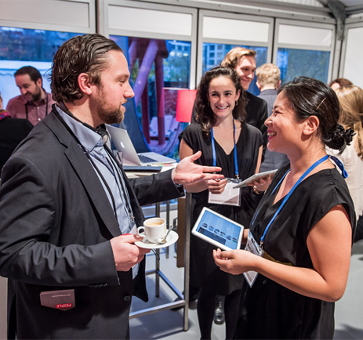
Become a TVI “Hang Out”
Opportunity to interact with potential candidates.
Provide Ongoing PD Opportunities
  Institutes and Professional Development
  Host webinars and/or statewide trainings
Will benefit your own teachers and “improve the applicant pool”

Slide 13
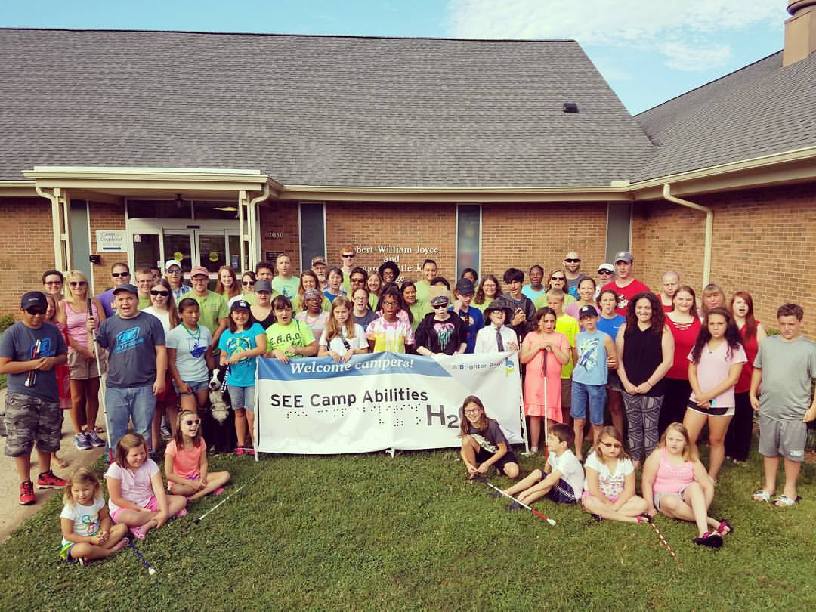
Summer Camps
Provide multiple camps.
Different: themes, ECC areas, ages
Becomes a recruitment opportunity if TVI’s from around the state can apply to work at the camps

Slide 14
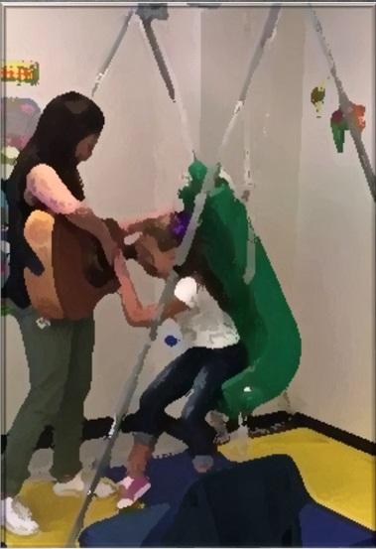
Recruiting Outside the Vision Field
  Special Ed. Classrooms in Public Schools
  Non-Profit Organizations
  Department of Human Services
  Early Intervention Programs
  Gen. Ed. Teachers interested in vision field

Slide 15

Consider Lateral Entry
Partner with university programs to offer remote or satellite classrooms
  Offer tuition reimbursement for successfully complete courses.
  Access to learning library to research and learn.
Co-Teaching Opportunities

Slide 16
Discerning High Quality Professionals
Knowledge and experience are important but they are just one aspect of discerning a high quality professional.

Slide 17

Observe Interactions
      In many environments
        Hallways
        Classrooms
        Office
        Other?
      With administrators
      With students
      With assistants
      With team members

Slide 18
Characteristics of a Professional
Humble
Be complimentary, it’s not all about you!, help others with menial tasks, acknowledge weaknesses, offer/receive apologies
Hungry
go above & beyond, passion for job, take personal responsibility for team success, take on challenging tasks, look for opp. to grow
Smart
Understand team dynamics, show empathy, interest in team, attentive listener, choose words carefully, adjust behavior & style
The Five Dysfunctions of a Team by Patrick Lencioni identify the following characteristics of a professional

Slide 19
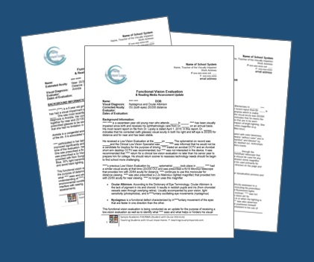
Work Samples
    Request sample FVE/LMA reports written for:
      academic & M.D. student,
      Various ages.
    Written or verbal Low vision & minimal or no vision,
    description of activities, lessons, instructional strategies
      For academic & M.D. students
      For braille readers & dual readers

Slide 20
Strategies for Fostering Career Growth
Don’t settle for “warm bodies”

Slide 21
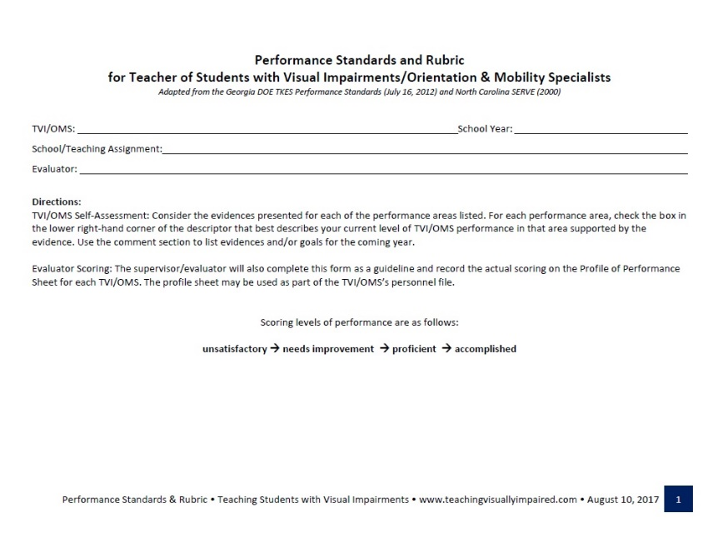
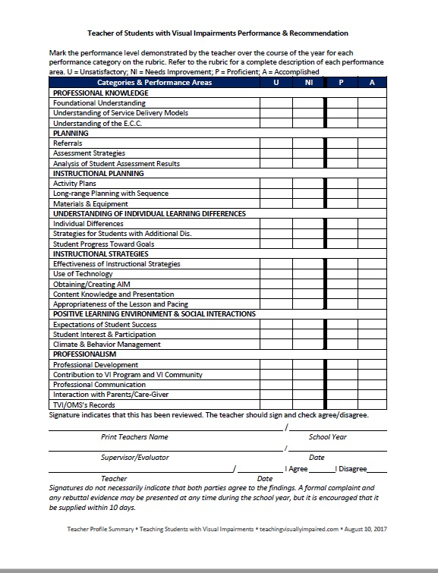
Self Evaluation
Performance plan using standards specific to visual impairments
Rubrics specify what is expected and what is needed to improve.
Set clear expectations for teachers and address bad attitudes and underperformers

Slide 22

Annual Reviews
Provide Feedback that is:
  Encouraging
  Immediate
  Honest
  Insightful
  Individualized
  Specific
  *This will encourage TVI’s to produce better results OR provide documentation for corrective action

Slide 23

Support for New TVI’s
Offer Mentoring, collaboration & modeling
Offer incentives to mentors (e.g. money, access to coursework to see latest trends, continuing education credits)
Samples:
  FVELMA reports,
  activity/lesson plan sharing

Slide 24
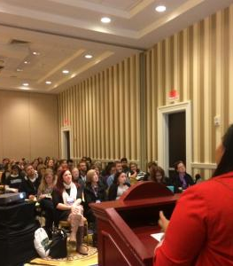
Trainings/Workshops
Host annual or bi-annual VI conferences
Workshops specific to caseload concerns
Workshops on best practice
Wide range of presentations, courses, and conferences to meet professional needs
    All areas of the ECC
    Instructional strategies
    Vendor demonstrations & trainings

Slide 25

Permit Job Growth/Change
You WANT teachers who strive to grow and not be complacent.
Provide job opportunities that allow TVI’s to grow in their areas of interest or add new areas of certification.
Classroom/Itinerant/Outreach
Leadership Opportunities
Work on Teams (Assessment Teams, Braille Challenge, Very Special Arts, Sensory Gardens, Recreation & Sporting Events, Assistive Technology)

Slide 26

Alternative Professional Development Activities
Professional Learning Teams
Contribute to curriculum development
Publish an original work (newsletter, book, journal article, software, etc.)
Present workshops at conferences, VI meetings, or to teams
Write grants
Coach/mentor student teachers, new teachers or teachers in need
Pursue additional certification in VI field

Slide 27
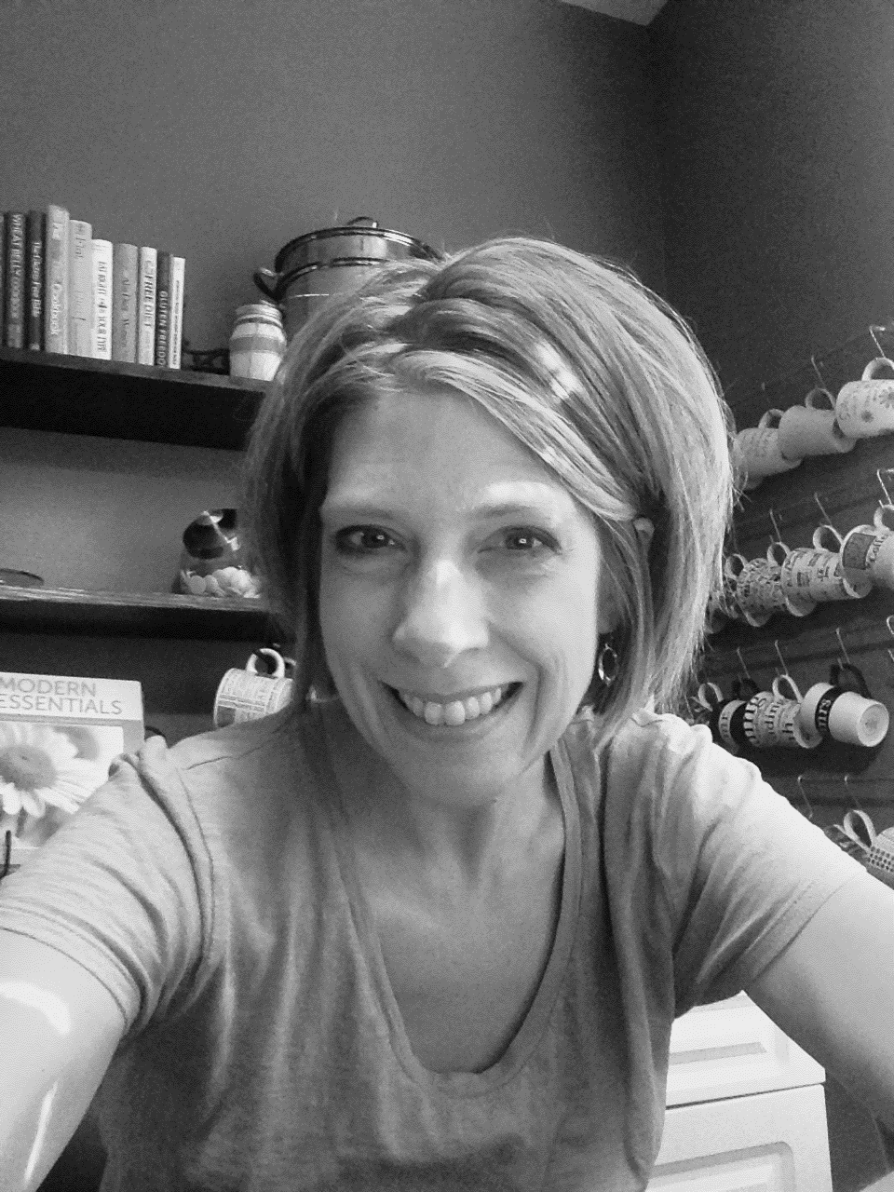
Contact Me
Carmen Willings
Teaching Students with Visual Impairments
www.teachingvisuallyimpaired.com
Teacher of students with Visual Impairments
North Forsyth High School
3635 Coal Mountain Rd.
Cumming, GA 30028
c.willings@teachingvisuallyimpaired.com

