Slide 1



Good Hygiene
TVI’s Guide to Teaching the ECC:
An Interactive Matching Activity
by Carmen Willings
www.teachingvisuallyimpaired.com

Slide 2


Use soapy warm water to wash your hands.

Slide 4



Count to 20 or sing a song from a band.

Slide 6

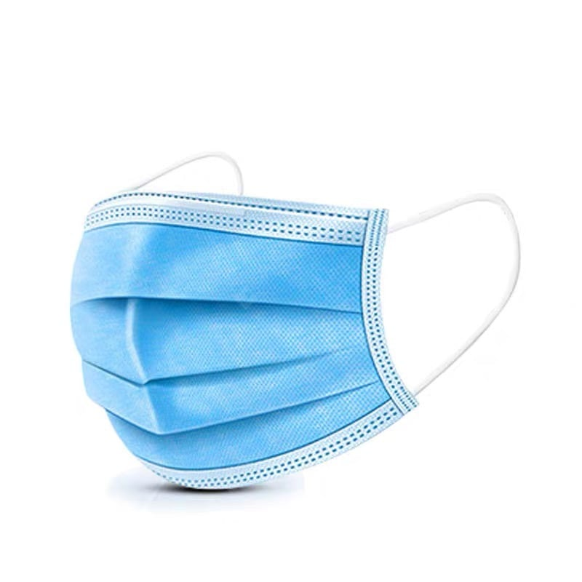
If you sneeze or cough, use a tissue to cover.

Slide 8
Keep your distance between one another.

Slide 10
Don’t touch your mouth, nose, or eyes.

Slide 12
Staying at home when you are sick is wise.

Slide 14
Wear a facemask if you don’t feel well.

Slide 16
Clean your house for a nice fresh smell!

Slide 18
The End

